Slide 1
Document for Case Study – Cyclistic Bike Share (Google Capstone Project)
Broad objective of stakeholders
The director of marketing believes the company’s future success depends on maximizing the number of annual memberships.
Therefore, your team wants to understand how casual riders and annual members use Cyclistic bikes differently. Analyzing the Cyclistic historical bike trip data to identify trends.
From these insights, your team will design a new marketing strategy to convert casual riders into annual members.
But first, Cyclistic executives must approve your recommendations, so they must be backed up with compelling data insights and professional data visualizations.
Company Details (Cyclistic):
No of bicycles & docking stations: 5800 and 600 respectively
Differentiator from competitors – Offers alternatives for disabled people like hand tricycles, cargo bikes etc
% Of traditional & alternative bikes – 92% and 8%
Type of ride (Leisure & Everyday commute) – 70% and 30%
Problem Statement or Objective: How to convert leisure riders into annual members.

Slide 2
Approach towards the case study:
Scope:
I have considered 12 months of data pertaining to the year 2021 (Jan-Dec). There are total 12 csv files.
The entire data cleaning , analysis and visualisation has been done in R.
Install and load the packages (tidyverse, janitor, lubridate)
Importing the data into R
Combining all the 12 data frame into one data frame called bike_rides.
Data Cleaning:
Before we start analysing the data, we need to look for errors by cleaning the data. Some points that I look at are as follows:
Data types for columns
Null values
Duplicates
#convert column names "started_at" and "ended_at" to date time format as they are originally shown as character type
#removing empty rows

Slide 3
Preparation for data analysis:
In the case study, we are required to find out the average ride length which I have called it as trip_duration. We already have the started_ at and ended_at columns which will help in determining the trip_duration.
#create columns for trip_duration,
# ensure that we want to work with trip duration that are not less than 0
#check data type for column trip_duration & convert to numeric
# convert trip_duration to numeric type
# create column date, month, day_of_week, day, year
The above columns have been created so as to analyse the data based on different parameters.

Slide 4
Data analysis & Visualisation:
#run few calculations to find out min,max,median,mean trip duration but it makes more sense to find out the above for member and casual
Member_casual | average_trip_duration (seconds) | min_trip_duration (seconds) | max_trip_duration (seconds) | median_trip_duration (seconds)
casual | 1814 | 0 | 3356649 | 957
member | 801 | 0 | 89996 | 576
From the above table we can conclude that casual took longer rides than member as the average trip duration for casual is more than the average trip duration of casual

Slide 5
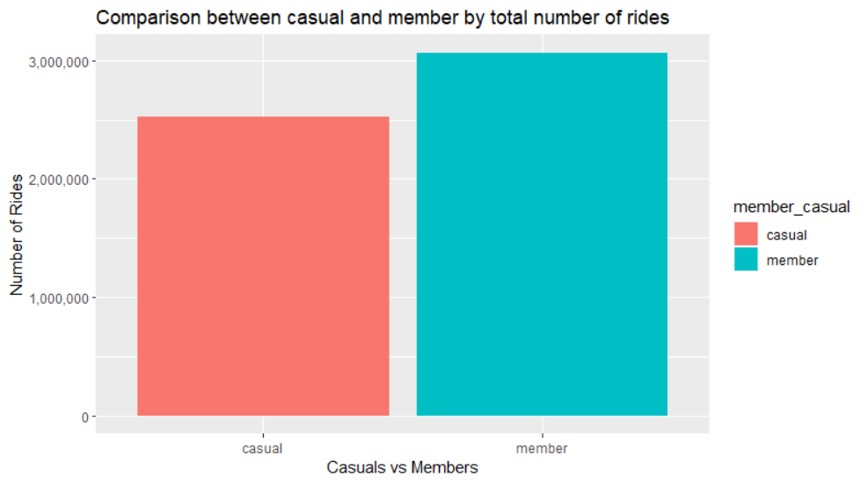
Casual: Total No of rides = 2525456 (account for 45% of the total rides)
Member: Total No of rides = 3064690 (account for 55% of the total rides)

Slide 6
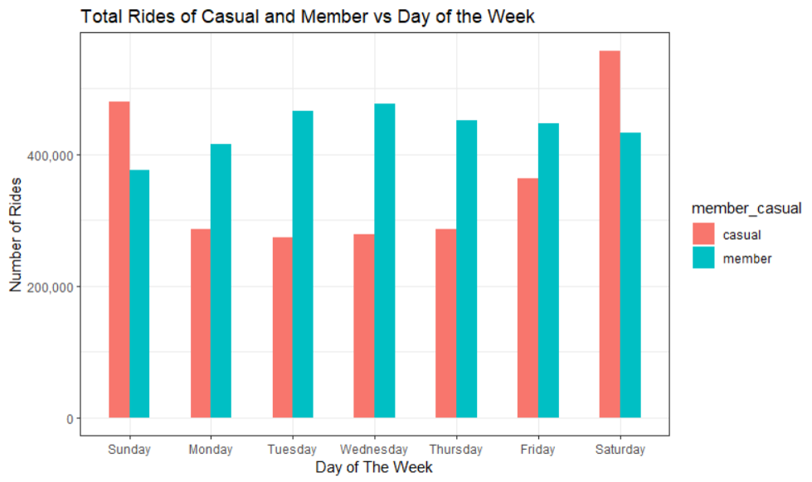
Casual: Tend to ride more on weekends as compared to weekdays while they are pretty constant throughout the weekday with a slight jump in Friday.
Member: Tend to ride the most on weekdays with the weekends being the lowest.

Slide 7
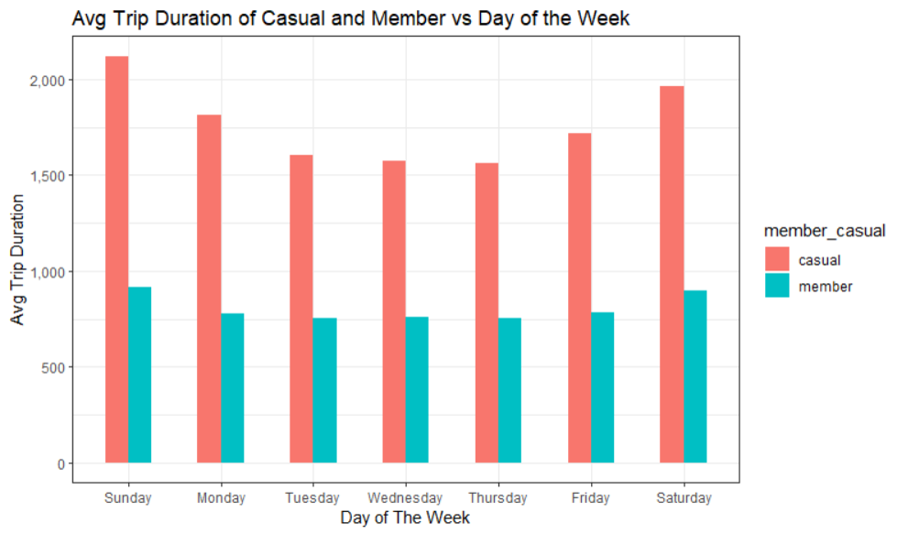
Causal: During the weekends, the avg trip duration is the highest with Sunday getting the 1st place. Even on weekdays, when the number of rides/trips is more for member, the avg trip duration of casual far exceeds that of member.
Member: The avg trip duration for members is almost constant throughout the week. (Less than 1000 secs).

Slide 8
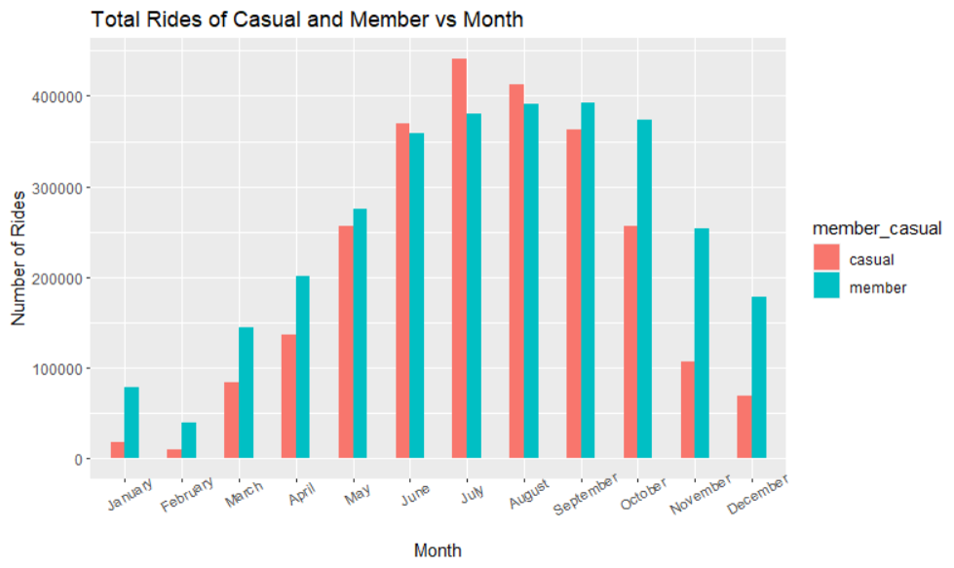
Casual: March to July shows an increasing trend in the number of rides and then it starts to taper down from August to February. In June, July and August, the total number of rides are more than that of member.
Member: February to July shows an increasing trend in the number of rides and then it starts to taper down from August to January. In August and September, member have the highest number of rides.

Slide 9
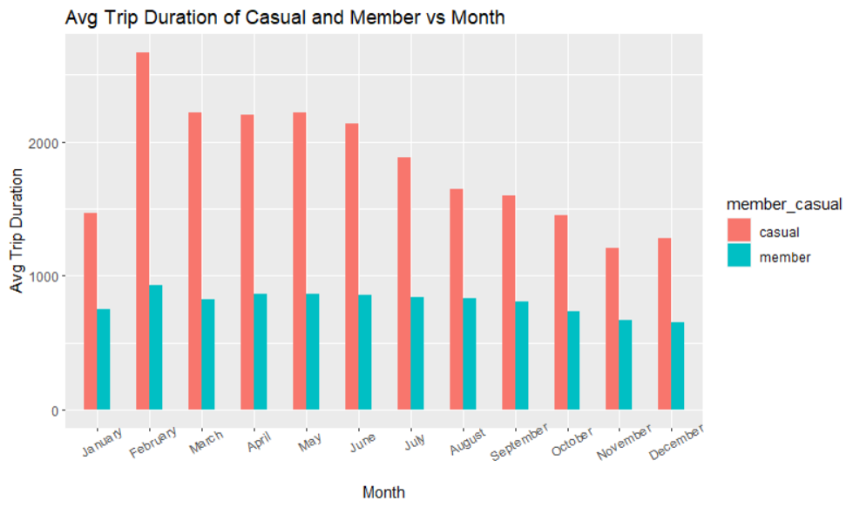
Casual: Avg Trip Duration is higher in every month when compared to member. Even though the lowest number of rides were in February, the highest average trip duration is also in the same month.
Member: Avg Trip Duration is almost constant throughout.

Slide 10
Conclusion:
Casual accounts for 45% of the total rides while members account for 55%.
While on average, the number of rides belonging to members are more but the average trip duration of casual has always been higher.
Maximum number of rides for both casual and member take place in the months from June to September.
Number of rides for casual is very high on weekends as compared to weekdays which is the preferred time period for member
Recommendation:
Slash the rates for bike rides on weekdays as compared to weekends. This will help in converting the number of casual riders who ride on weekends to start riding on weekdays.
We can create hubs near metro or train stations to have more bikes on weekdays so as to encourage casual riders to pick up a bike and commute to work.

